Slide 1
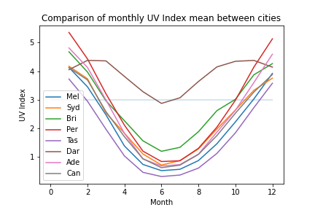
How does skin cancer compare to UV index?

Slide 2
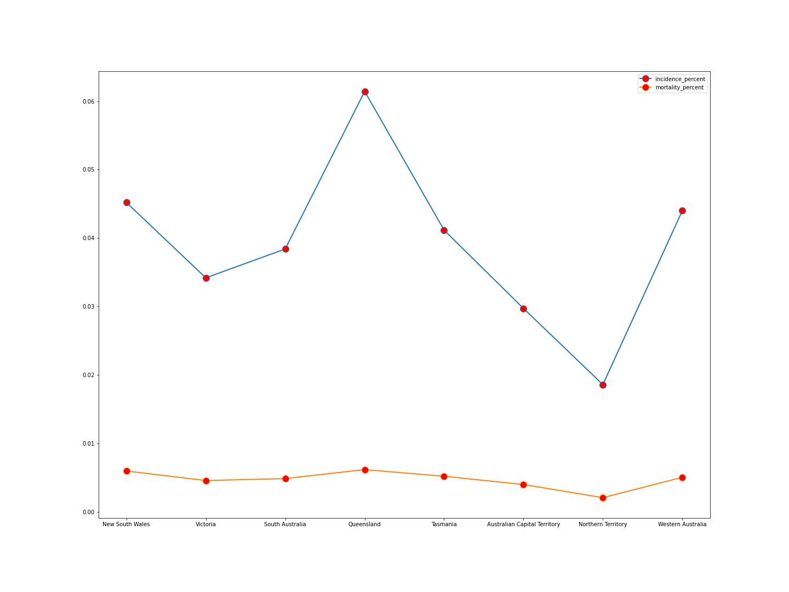
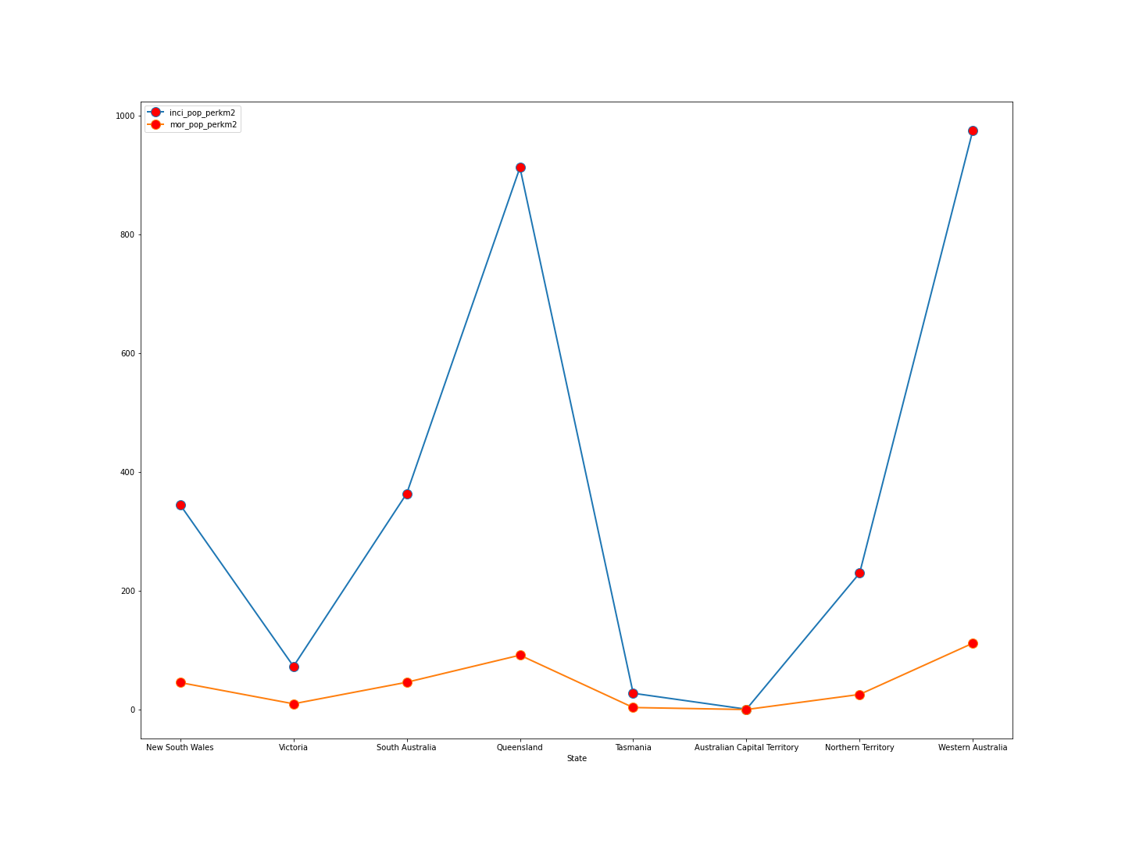
How does skin cancer compare to UV index?

Slide 3
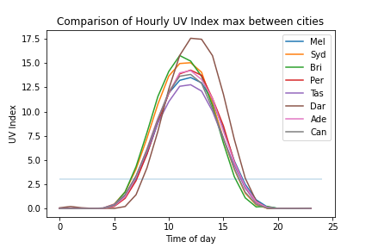
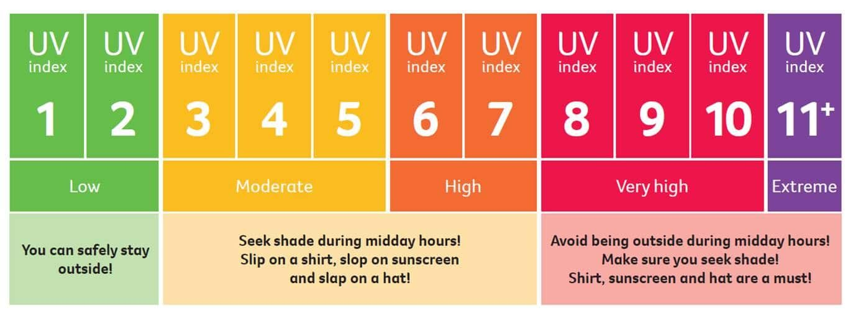
How does the UV index look during different times of the day?
*Table above as per https://www.myuv.com.au/

Slide 4
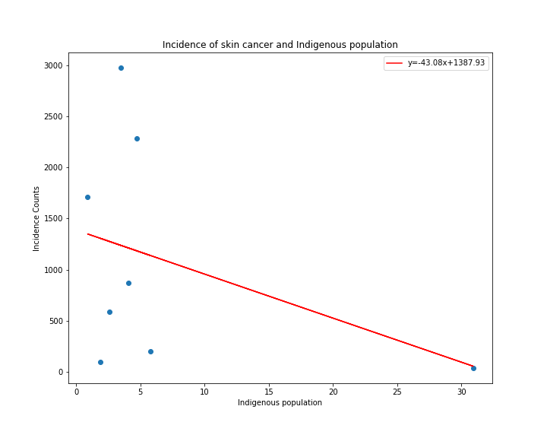
How skin cancer affects the Indigenous community

Slide 5
Findings & Conclusions
How serious is skin cancer in Australia?
Top deadly diseases in Australia
Australia is the skin cancer capital of the world
There’s been an upward trend in skin cancer cases since 1970
What’s being done to prevent it?
Budget of 2022-23
Expenditure on risk factors
Expenditure on treatment

Slide 6
Findings & Conclusions
Is it preventable?
YES!
Being Sun Smart
Know the UV index
Slip, Slop, Slap. Seek and Slide
Use common sense!

